Slide 1



Survey of Imperative Style Turing Complete proof techniques and an application to prove Proteus Turing Complete
By: Isaiah Martinez
1

Slide 2
Table of contents
1
2
3
Introduction
Proteus
Turing Complete Proofs
Turing Machine, Theorems, and Turing Completeness
Description of the programming language
Different ways to show a system is Turing Complete
4
5
Proteus Proofs
Conclusions
My proofs to demonstrate Proteus Turing Complete
Final remarks and future thoughts
2

Slide 3
01
Introduction
Turing Machines (TM)
The Church-Turing Thesis (CTT)
Rice’s Theorem
Turing Completeness
3

Slide 4
The Turing Machine
0 1 1 0 0 1 0
…
…
…
…
…
…
Read/Write Head
Inner Logic
4

Slide 5
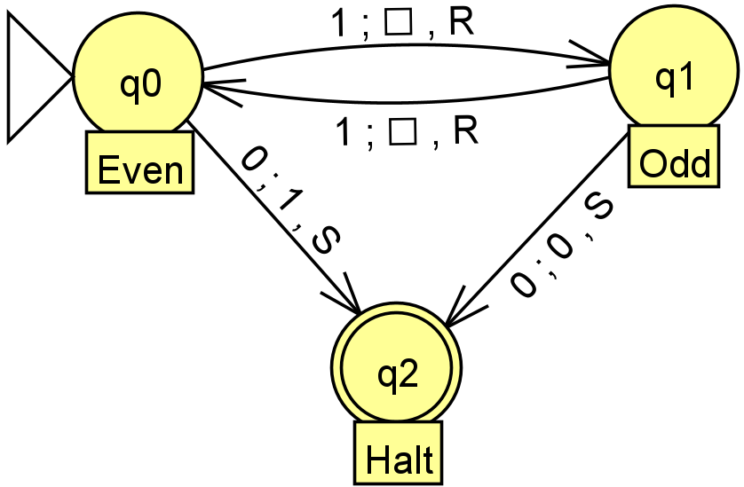
Example of a TM
Given any amount of 1’s followed by a 0.
Goal is to find the parity of the amount of 1’s.
1110 => 0 (odd)
110 => 1 (even)
5

Slide 6
Walkthrough of Sample TM
110
1
Even!
6

Slide 7

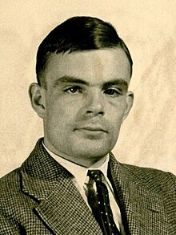
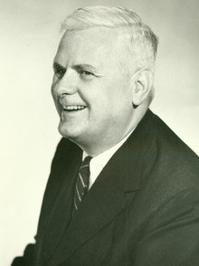
The Church-Turing Thesis
Every effectively calculable function can be computed by a Turing Machine
7
Notes:
https://upload.wikimedia.org/wikipedia/commons/thumb/4/40/Alan_Turing_%281912-1954%29_in_1936_at_Princeton_University_%28cropped%29.jpg/220px-Alan_Turing_%281912-1954%29_in_1936_at_Princeton_University_%28cropped%29.jpg
https://upload.wikimedia.org/wikipedia/en/thumb/a/a6/Alonzo_Church.jpg/220px-Alonzo_Church.jpg

Slide 8


Rice’s Theorem
Let $φ$ be an admissible numbering of partial computable functions. Let P $⊆$ $ℤ$.
Suppose that:
P is non-trivial: P is neither empty nor $ℕ$ itself.
P is extensional: $∀$ m,n $∈$ $ℕ$, if $φ_{m}$ = $φ_{n}$ then m $∈$ P $⇔$ n $∈$ P.
Then P is undecidable.
The only decidable index sets are $∅$ and $ℕ$.
8

Slide 9
Rice’s Theorem applied to Programming Languages
Programs are undecidable.
Only able to determine simplistic things in nature but does not have an answer to complex problems like The Halting Problem.
9

Slide 10





Turing Completeness
For a given system to be Turing Complete, it must be capable of performing any computation that a TM can perform.
10
Notes:
https://logos-download.com/9988-python-logo-download.html
https://www.numi.tech/software-logos/c-plus-plus
https://vectorified.com/magic-the-gathering-vector
https://logos-world.net/minecraft-logo/
https://www.vecteezy.com/

Slide 11
02
Proteus
P
Actor Model
Use Cases
11

Slide 12
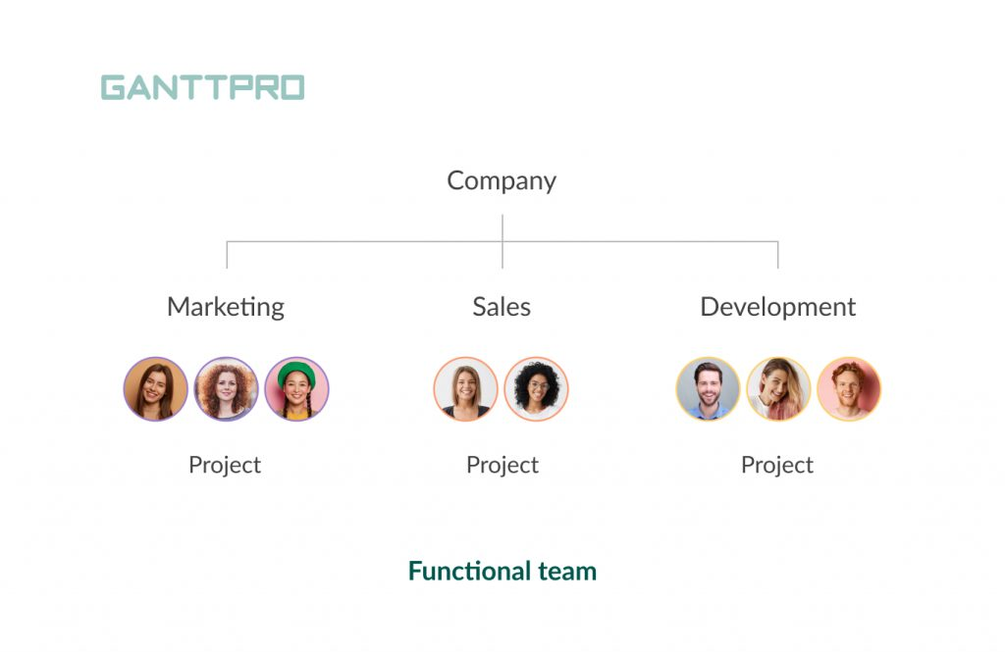
Actor Model
Actors: Individuals within the overall group
States: Status of the individual
Events: Messages sent between individuals
Different teams in a company
12
Notes:
https://blog.ganttpro.com/en/types-of-teams/

Slide 13
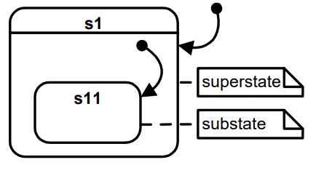

Proteus Language Design Details
3/2 = 1
Truncation to remain closure in $ℤ$
States can be HSMs
Cannot create/destroy State Machines dynamically
13
Notes:
https://www.cis.upenn.edu/~lee/06cse480/lec-HSM.pdf

Slide 14

Use Cases
Error
Repair
Awake
Gather
Measure
Send
Sleep
14
Notes:
While on, can determine the health of the machine whilst recording the data. If the machine needs repairs, then it can perform those repairs. Assuming the repairs are independent from the data collection operations, then the rover is able to measure the data, and send it back to home base.

Slide 15
Turing Complete Proofs
03
Computer Engineering
Computer Science – Automata Theory
Software Engineering
Mathematics
15

Slide 16
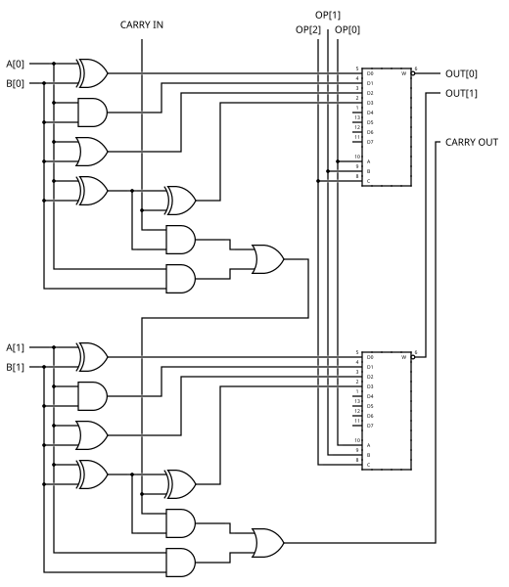
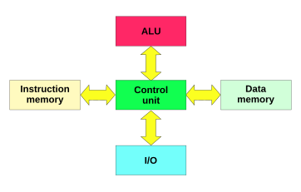
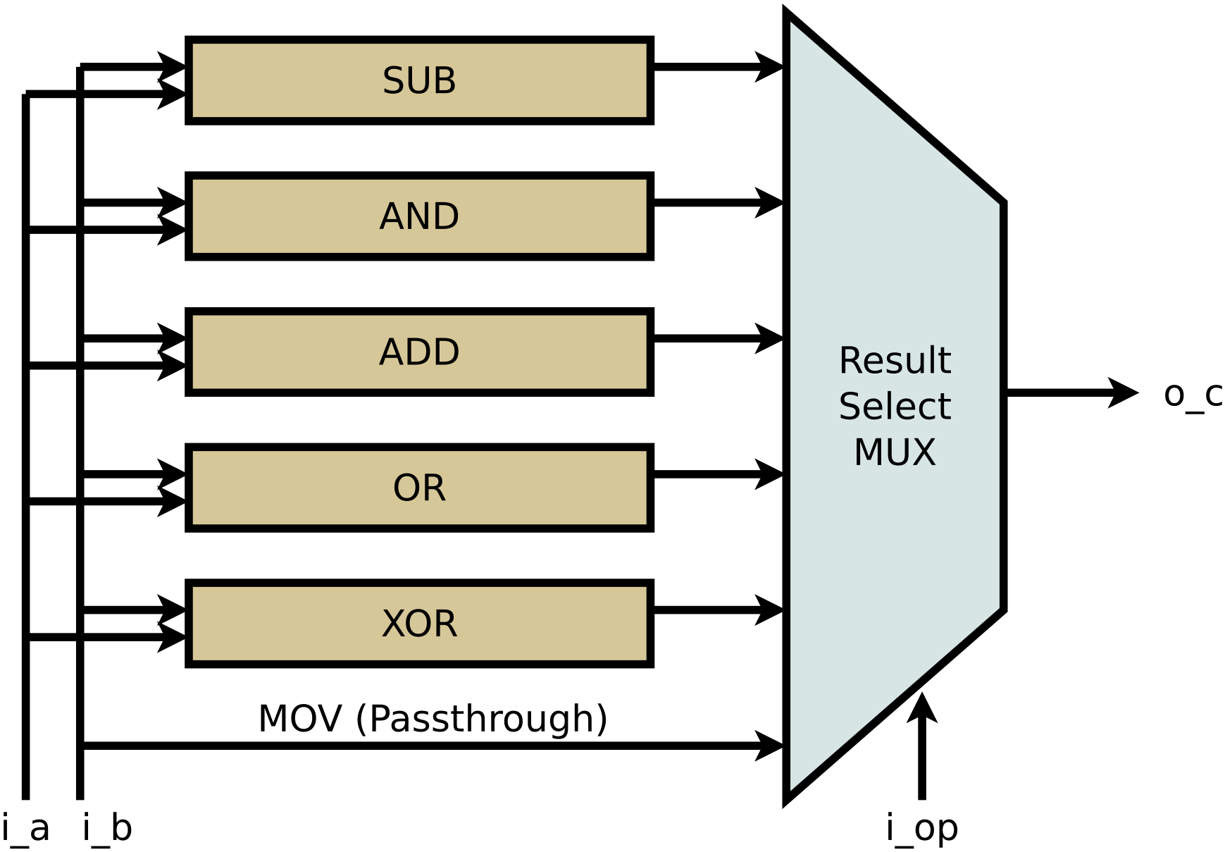
Computer Engineering
Logic Gates:
AND
OR
XOR
Circuitry:
ADD
SUB
MUX
Harvard Architecture
2-Bit ALU Schematic
16
Simplified 2-Bit ALU
Notes:
“File:Harvard architecture.svg - Wikimedia Commons,” Wikimedia.org, May 11, 2010. https://commons.wikimedia.org/wiki/File:Harvard architecture.svg
“File:2-bit ALU.svg - Wikibooks, open books for an open world,” Wikibooks.org, Oct. 18, 2011. https://en.wikibooks.org/wiki/File:2-bit ALU.svg
“A Simple ALU, drawn from the ZipCPU,” zipcpu.com. https://zipcpu.com/zipcpu/2017/08/11/simple-alu.html

Slide 17
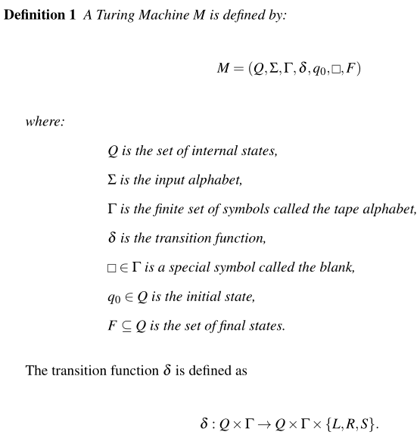
Computer Science – Automata Theory
The theoretical definition of a TM, reliant on an undecidable input
Used to represent TMs in a more concrete manner using mathematical notation
Many equivalent definitions
17
Notes:
Must have an undecidable input

Slide 18
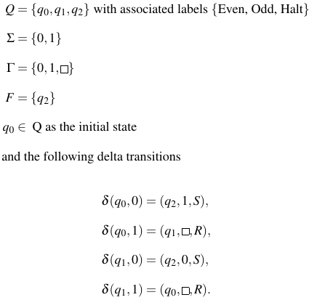
Example of a TM - Revisited
Sample TM
18

Slide 19
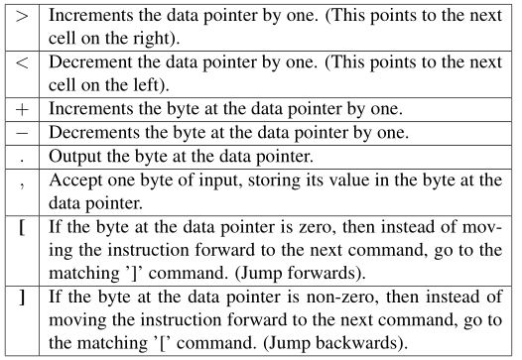
Software Engineering
Implement a known TC system:
Programmable Calculators
Programming languages
Cellular Automata
Brainfuck Instruction Set
19
Conway’s Game of Life
Rule 110
Notes:
“File:One-d-cellular-automaton-rule-110.gif - Wikimedia Commons,” Wikimedia.org, Nov. 20, 2018. https://commons.wikimedia.org/wiki/File:One-d-cellular-automaton-rule-110.gif
https://upload.wikimedia.org/wikipedia/commons/e/e5/Gospers_glider_gun.gif

Slide 20
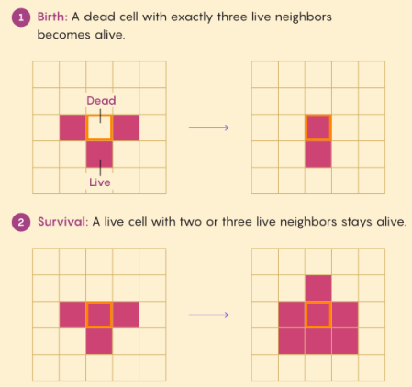
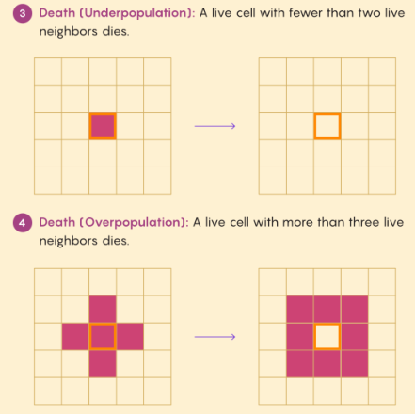
Software Engineering – Conway’s Game of Life
Rules for Conway’s Game of Life
20

Slide 21



Mathematics
Lambda Calculus:
x : A variable as a function parameter
λx.M : A lambda abstraction that is function definition with bound variable x as input and returns the body M
(M N) An application where it applies the function M to argument N
21
Notes:
https://www.pngitem.com/middle/iRwoRob_haskell-programming-language-logo-hd-png-download/
https://spin.atomicobject.com/elixir-test-multiple-environments/
https://www.redbubble.com/i/sticker/Racket-Programming-Language-large-logo-by-spdegabrielle/41182568.EJUG5

Slide 22
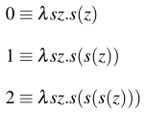
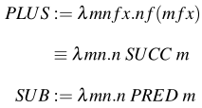
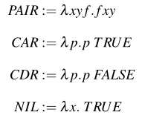
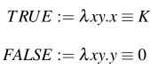

Lambda Calculus in Practice
Using SUCCession to create $ℕ$
Addition and Subtraction
Booleans
22
List Operations
Notes:
Car = first let
Cdr = last element
Pair = Cons

Slide 23
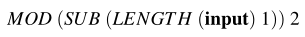
Example of a TM - Revisited
Simplified Lambda Calculus
Input: 11…10
Output: {0,1}
Sample TM
23

Slide 24
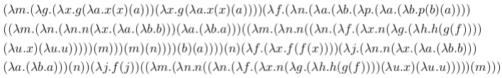
Lambda Calculus Expanded
MOD (INPUT 2)
Expansion of a simpler lambda calculus expression
24

Slide 25
04
Proteus Proofs
Formal definition using Automata Theory
Conway’s Game of Life
Rule 110
25

Slide 26
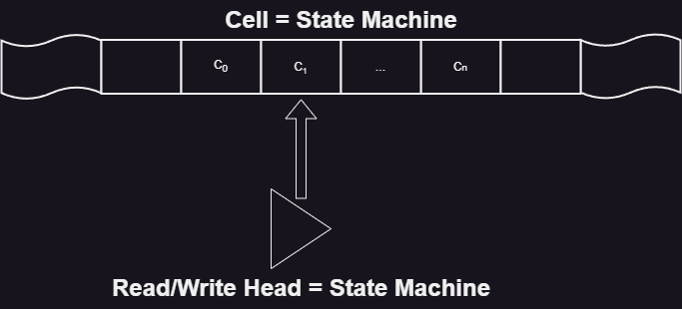
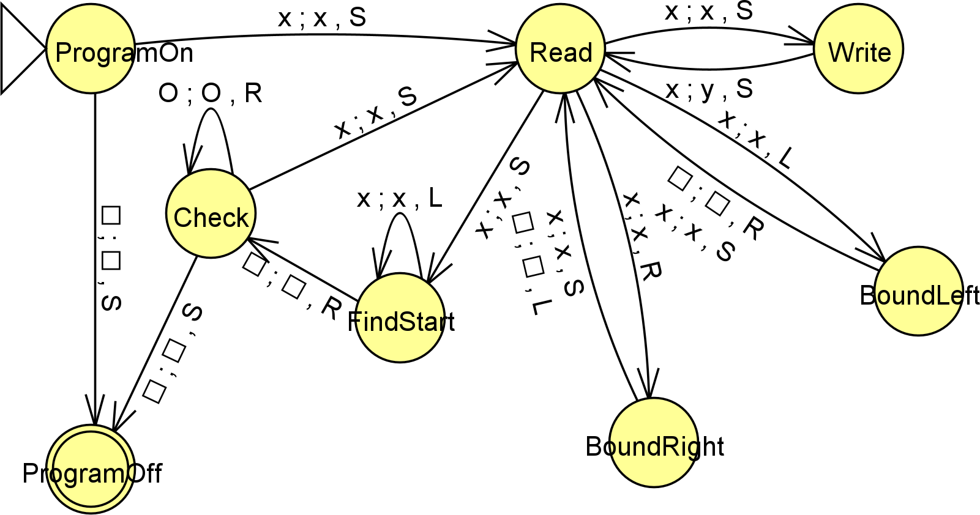
Automata Theory
C₀ C₁ … C_{n}
Using Rice’s Theorem, Proteus programs are undecidable
Must define a TM using Proteus
Note: all cells are state machines
Theoretical Design of TM
26
TM State Diagram
Notes:
More than happy to provide in depth explanation

Slide 27
TM made in Proteus – Program Start
Program Start in the partial TM State Diagram
Program has a predetermined list of cells that are in some state (On,Off, s_{i})
Read/Write Head (RWH) is initialized to the ProgramOn state indicating the program has just begun.
The RWH transitions to Read state for processing further operations from the program.
27

Slide 28
TM made in Proteus - Writing
Writing logic in the partial TM State Diagram
From the Read state, the program determines what to do
Suppose it is to write a new value (state) to the current cell (state machine). It enters the Write state and stays at the current cell. Then it updates the data at the current cell and stays at the current cell. The RWH then goes back to the Read state.
28

Slide 29
TM made in Proteus - Moving
If the RWH wants to move in a direction, it enters the BoundLeft/BoundRight state.
WLOG let the RWH want to move Left. If the RWH moves onto a blank (past c₀) then it moves one cell in the opposite direction (right) to remain within the confines of the predetermined tape (some c₀).
If the move remains on some c_{i} then the move is valid.
Moving logic in the partial TM State Diagram
29

Slide 30

TM made in Proteus - Halting
If the program wants to halt, it must ensure that all defined cells on the tape are in the “Off” state (i.e. $∀ c_{i}$ c_{i} = “Off”)
It begins by finding the first cell c₀ and checks each cell moving to the right one at a time.
If it encounters some c_{i} not in the “Off” state, then it enters the Read state.
Halting logic in the partial TM State Diagram
30

Slide 31
TM made in Proteus - Halting
If instead it encounters a blank, then it has moved past the final predefined cell (c_{n}). This means that all cells are in the “Off” state (i.e. c₀, c₁, …, c_{n} are in the “Off” state).
In such a case, the program stays at the current cell, enters the “ProgramOff” state and halts.
If an empty program is given, then the RWH immediately moves to the “ProgamOff” state.
Halting logic in the partial TM State Diagram
31

Slide 32
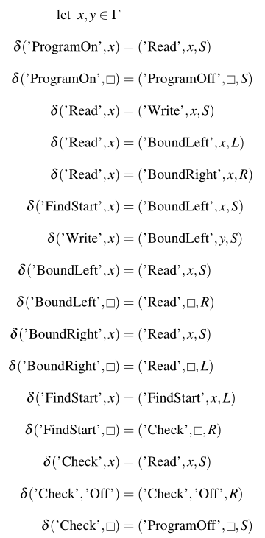
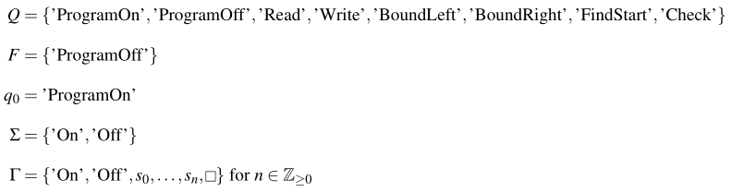
Automata Theory - Formal Definition
Formal Automata Definition for a TM
32

Slide 33
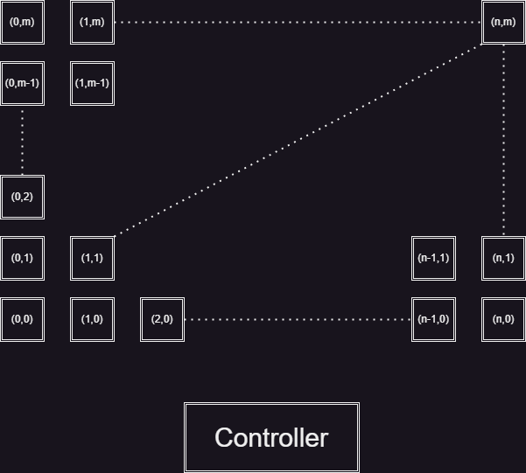
Conway’s Game of Life
Create the cartesian plane (2D) of cells using state machines
Additional non-planar HSM called the Controller for sending messages
Messages:
getDisplay(myName)
calculateNextState()
updateAllCells()
initializeCellValue(Value)
System Design
33
Notes:
1. getDisplay(myName): the current cell requests another cell for their currState value. It passes the current cells name so that the receiver may transmit the data back to this cell.
2. calculateNextState(): this event is sent from the controller to all cells. It instructs the cells to calculate their next state (true == On).
3. updateAllCells(): this event is sent from the controller to all cells. It instructs the cells to update their currCellIsOn to the value of nextStateCurrCellIsOn.
4. initializeCell(Value): this event is sent from the controller to all programmer-defined cells. It instructs the cell to update it’s currCellIsOn to the given Value, with Value ∈ {true,false}.

Slide 34
Conway’s Game of Life - Cells
Each cell holds the following data:
Local Variables:
myName :: String
Xcoord :: Int
Ycoord :: Int
currCellIsOn :: Boolean
nextStateCurrCellIsOn :: Boolean
States:
Display
CalculateNext
Update
(0,0)
Local Variables:
cell00
0
0
false
false
Initialized to Display state
34

Slide 35
Conway’s Game of Life - Controller
The controller holds the following data:
States:
Setup
Sends initializeCell with initial state
nextStage
Broadcasts to all cells to calculate their next state
Once all cells have updated values, broadcasts to all cells to update to the newly calculated state
Controller
Initialized to Setup state
35

Slide 36
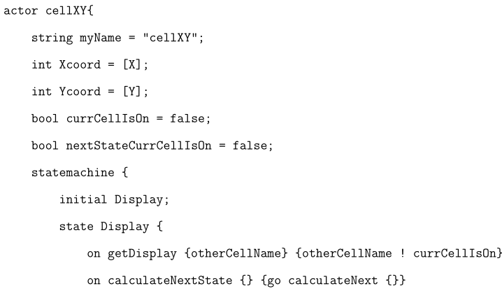
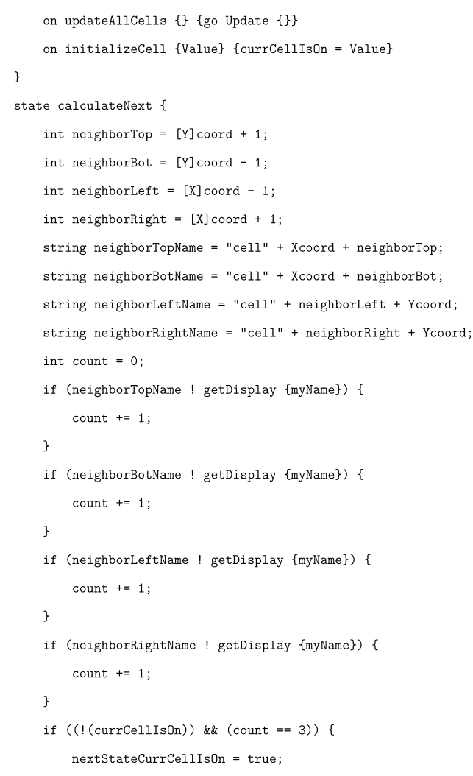
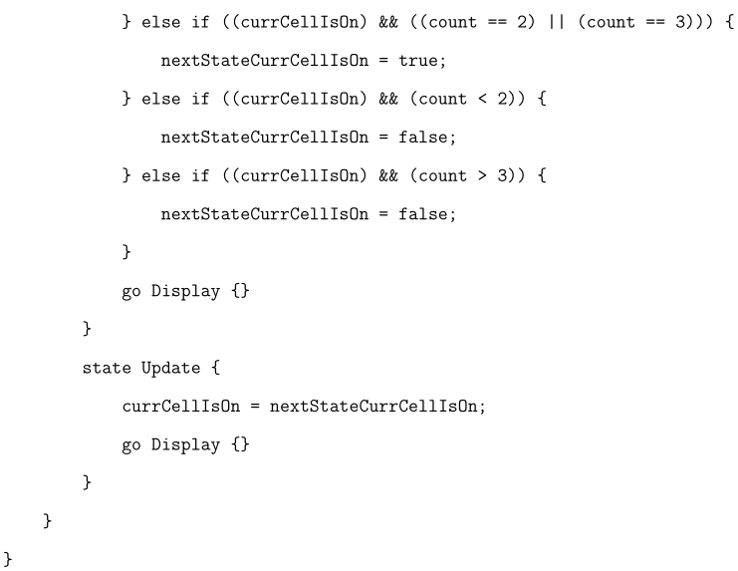
Conway’s Game of Life written in Proteus
36

Slide 37
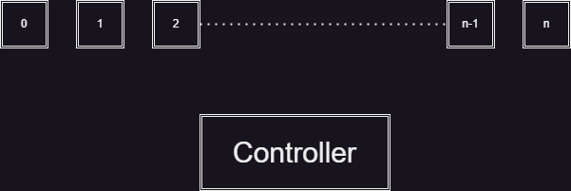
Rule 110
Create the 1D grid of cells using state machines
Additional non-planar HSM called the Controller for sending messages
Messages:
getDisplay(myName)
calculateNextState()
updateAllCells()
initializeCellValue(Value)
System Design
37
Notes:
1. getDisplay(myName): the current cell requests another cell for their currState value. It passes the current cells name so that the receiver may transmit the data back to this cell.
2. calculateNextState(): this event is sent from the controller to all cells. It instructs the cells to calculate their next state (true == On).
3. updateAllCells(): this event is sent from the controller to all cells. It instructs the cells to update their currCellIsOn to the value of nextStateCurrCellIsOn.
4. initializeCell(Value): this event is sent from the controller to all programmer-defined cells. It instructs the cell to update it’s currCellIsOn to the given Value, with Value ∈ {true,false}.

Slide 38
Rule 110 - Cells
Each cell holds the following data:
Local Variables:
myName :: String
coord :: Int
currCellIsOn :: Boolean
nextStateCurrCellIsOn :: Boolean
States:
Display
CalculateNext
Update
0
Local Variables:
cell00
0
false
false
Initialized to Display state
38

Slide 39
Rule 110 - Controller
The controller holds the following data:
States:
Setup
Sends initializeCell with initial state
nextStage
Broadcasts to all cells to calculate their next state
Once all cells have updated values, broadcasts to all cells to update to the newly calculated state
Controller
Initialized to Setup state
39

Slide 40
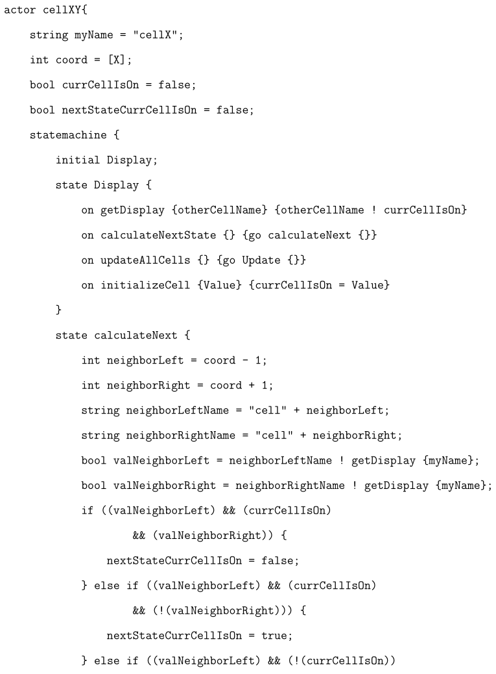
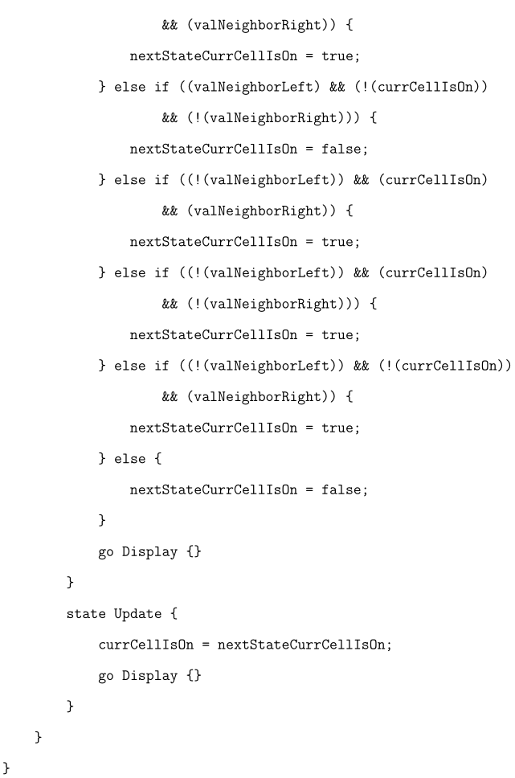
Rule 110 written in Proteus
40

Slide 41
05
Conclusion
Summary
Future Thoughts
Final Remarks
41

Slide 42
Summary
Proteus is TC, as shown by the 3 different examples:
Automata Theory with Undecidable Input
Implementation of CGoL
Implementation of Rule 110
Theoretical Design of TM
42
System Design for Rule 110
System Design for CGoL

Slide 43

Future Thoughts
No way to implement interactive user input for a brainfuck interpreter
Pre-feeding data may fix issue
Truncation to maintain closure of $ℤ$ $⇒$ there is no way to implement a proper calculator directly
Lambda Calculus is highly theoretical and requires definitions for restructuring the language
Very tedious to create a complete architecture for a functional computer, one logical gate at a time.
43

Slide 44
Final Remarks
Different disciplines approaches to Turing Completeness
2
Proteus being useful IRL
1
TC
44

Slide 45




Thank You!
Questions?
45

Slide 46
References
R. Gandy, “Church’s Thesis and Principles for Mechanisms,” The Kleene Symposium, pp. 123–148, Jun. 1980.
Sakharov, Alex. “Rice’s Theorem.” From MathWorld–A Wolfram Web Resource, created by Eric W. Weisstein, Wolfram.com, 2024. https://mathworld.wolfram.com/RicesTheorem.html
Wikipedia Contributors, “Rice’s theorem,” Wikipedia, Sep. 24, 2019. https://en.wikipedia.org/wiki/Rice%27s theorem
“Brainfuck,” Wikipedia, Oct. 05, 2021. https://en.wikipedia.org/wiki/Brainfuck
262588213843476, “Basics Of BrainFuck,” Gist, Oct. 29, 2024. https://gist.github.com/roachhd/dce54bec8ba55fb17d3a
A. Churchill, S. Biderman, and A. Herrick, “Magic: The Gathering is Turing Complete.”
“I Made A Working Computer With Just Redstone!,” www.youtube.com. https://www.youtube.com/watch?v=CW9N6kGbu2I
G. Branwen, “Surprisingly Turing-Complete,” gwern.net, Dec. 2012, Available: https://gwern.net/turing-complete
“Accidentally Turing-Complete,” beza1e1.tuxen.de. https://beza1e1.tuxen.de/articles/accidentally_turing_complete.html
B. McClelland, “Adding Runtime Verification to the Proteus Language,” CSUN, May 2021. P. Rendell, ”A Universal Turing Machine in Conway’s Game of Life,” 2011 International Conference on High Performance Computing & Simulation, Istanbul, Turkey, 2011, pp. 764-772, doi: 10.1109/HPCSim.2011.5999906.
P. Linz, An Introduction to Formal Languages and Automata. Jones & Bartlett Learning, 2016.
Jeffrey Outlaw Shallit, A second course in formal languages and automata theory. Cambridge; New York: Cambridge University Press, 2009.
46

Slide 47
References
M. Bic¸er, F. Albayrak and U. Orhan, ”Automatic Automata Grading System Using JFLAP,” 2023 Innovations in Intelligent Systems and Applications Conference (ASYU), Sivas, Turkiye, 2023, pp. 1-4, doi: 10.1109/ASYU58738.2023.10296744.
Dezani-Ciancaglini Mariangiola And J. R. Hindley, “Lambda-Calculus,” Wiley Encyclopedia of Computer Science and Engineering, pp. 1–8, Sep. 2008, doi: https://doi.org/10.1002/9780470050118.ecse212.
M. Dezani-Ciancaglini and J. R. Hindley, “Lambda-Calculus,” Nov. 2007, Available: https://www.researchgate.net/publication/228107078 Lambda-Calculus
R. Rojas, “A Tutorial Introduction To The Lambda Calculus,” 2015, Available: https://arxiv.org/pdf/1503.09060
“Home — nand2tetris,” nand2tetris, 2017. https://www.nand2tetris.org/
Noam Nisan, ELEMENTS OF COMPUTING SYSTEMS : building a modern computer from first principles. 2020.
B. McClelland et al., “Towards a Systems Programming Language Designed for Hierarchical State Machines,” pp. 23–30, Jul. 2021, doi: https://doi.org/10.1109/smc-it51442.2021.00010.
speeder, “How does the Brainfuck Hello World actually work?,” Stack Overflow, May 30, 2013. https://stackoverflow.com/questions/16836860/how-does-the-brainfuck-hello-world- actually-work/19869651#19869651
“brainfuck-Esolang,” Esolangs.org, 2023. https://esolangs.org/wiki/Brainfuck#Self-interpreters
Brainfuck.org, 2024. https://brainfuck.org/dbfi.b
Wikipedia Contributors, “Cellular automaton,” Wikipedia, Dec. 05, 2019. https://en.wikipedia.org/wiki/Cellular automaton
E. W. Weisstein, “Cellular Automaton,” From Mathworld–A Wolfram Web Resource, math-world.wolfram.com. https://mathworld.wolfram.com/CellularAutomaton.html
47

Slide 48
References
A. Ilachinski, Cellular Automata. World Scientific, 2001.
“Math’s ‘Game of Life’ Reveals Long-Sought Repeating Patterns — Quanta Magazine,” Quanta Magazine, Jan. 18, 2024. https://www.quantamagazine.org/maths-game-of-life-reveals- long-sought-repeating-patterns-20240118/
Code & Optimism, “How to Write A Turing-Complete Programming Language In 40 Minutes In Ruby Using Bable-Bridge,” YouTube, Sep. 19, 2012. https://www.youtube.com/watch?v= Uoyufkb5lk
M. Kenyon, “How to Write a Brainfuck Interpreter in C#,” Thesharperdev.com, Oct. 12, 2019. https://thesharperdev.com/how-to-write-a-brainfuck-interpreter-in-c/
“Compiling to Brainf#ck - Meep.,” InJuly, 2024. https://injuly.in/blog/bfinbf/index.html
srijan-paul, “GitHub - srijan-paul/meep: A programming language that compiles to brainfuck.,” GitHub, 2020. https://github.com/srijan-paul/meep
M. Ueding, “Creating a Brainfuck interpreter,” Martin Ueding, Apr. 19, 2023. https://martinueding.de/posts/creating-a-brainfuck-interpreter/
“Functional Programming,” learn.saylor.org. https://learn.saylor.org/mod/book/tool/print/- index.php?id=33044&chapterid=13087
Wikipedia Contributors, “Lambda calculus,” Wikipedia, Jan. 02, 2020. https://en.wikipedia.org/wiki/Lambda calculus
“Collected Lambdas,” jwodder.freeshell.org. https://jwodder.freeshell.org/lambda.html
Wikipedia Contributors, “SKI Combinator calculus,” Wikipedia, Oct. 28, 2024. https://en.wikipedia.org/wiki/SKI combinator calculus
48

Slide 49
References
“Reddit - Dive into anything,” Reddit.com, 2017. https://www.reddit.com/r/ProgrammerHu-mor/comments/78z90f/when you need to know if a number is even or odd/
“Reddit - Dive into anything,” Reddit.com, 2017. https://www.reddit.com/r/ProgrammerHu- mor/comments/78z90f/comment/doylzry/
“The Excel Formula Language Is Now Turing-Complete,” InfoQ. https://www.infoq.com/articles/excel-lambda-turing-complete/
“A deep dive into an NSO zero-click iMessage exploit: Remote Code Execu- tion,” Blogspot.com, 2021. https://googleprojectzero.blogspot.com/2021/12/a-deep-dive-into- nso-zero-click.html?m=1
Wikipedia Contributors, “Actor model,” Wikipedia, Nov. 14, 2019. https://en.wikipedia.org/wiki/Actor model
L. Nigro, “Parallel Theatre:
An actor framework in Java for high performance computing,” Simulation Modelling Practice and Theory, vol. 106, p. 102189, Jan. 2021, doi: https://doi.org/10.1016/j.simpat.2020.102189.
GeeksForGeeks, “Functional Programming Paradigm - GeeksforGeeks,” GeeksforGeeks, Jan. 02, 2019. https://www.geeksforgeeks.org/functional-programming-paradigm/
coq, “GitHub - coq/coq: Coq is a formal proof management system. It provides a formal language to write mathematical definitions, executable algorithms and theorems together with an environment for semi-interactive development of machine-checked proofs.,” GitHub, Sep. 04, 2024. https://github.com/coq/coq?tab=readme-ov-file
“A Simple ALU, Drawn From The ZipCPU,” zipcpu.com. https://zipcpu.com/zipcpu/2017/08/11/simple-alu.html
Y. N. Patt and S. J. Patel, Introduction to computing systems : from bits and gates to C and beyond. Boston: Mcgraw-Hill\Higher Education, Cop, 2005.
49

Slide 50
Additional Slides
50

Slide 51
Proteus Grammar – Pt. 1
Program: DefEvent* DefGlobalConst* DefFunc* DefActor+
DefActor: 'actor' ActorName '{' ActorItem* '}'
ActorItem: DefHSM | DefActorOn | DefMember | DefMethod
DefActorOn: 'on' EventMatch OnBlock
DefHSM: 'statemachine' '{' StateItem* '}'
DefState: 'state' StateName '{' StateItem* '}'
StateItem: DefOn | DefEntry | DefExit | DefMember | DefMethod | DefState | InitialState
DefOn: 'on' EventMatch OnBody
EventMatch: EventName '{' [VarName (',' VarName)*] '}'
OnBody: GoStmt | OnBlock
OnBlock: Block
DefEntry: 'entry' '{' Block '}'
DefExit: 'exit' '{' Block '}'
DefMember: Type VarName '=' ConstExpr ';'
DefMethod: 'func' FuncName FormalFuncArgs ['->' Type] Block
InitialState: 'initial' StateName ';'
Block: '{' Stmt* '}'
Stmt: IfStmt | WhileStmt | DecStmt | AssignStmt | ExitStmt | ApplyStmt | SendStmt | PrintStmt | PrintlnStmt
DefEvent: 'event' EventName '{' [Type (',' Type )*] }' ';'
DefFunc: 'func' FuncName FormalFuncArgs ['->' Type] Block
DefGlobalConst: 'const' Type VarName '=' ConstExpr ';'
ExitStmt: 'exit' '(' NUMBER ')' ';'
ReturnStmt: 'return' Expr ';'
DecStmt: Type VarName '=' Expr ';'
AssignStmt: VarName '=' Expr ';'
ApplyStmt: ApplyExpr ';'
SendStmt : HSMName '!' EventName ExprListCurly ';'
PrintStmt : 'print' ExprListParen ';'
PrintlnStmt : 'println' ExprListParen ';'
FormalFuncArgs : '(' [Type VarName (',' Type VarName)*] ')'
ExprListParen :'(' [Expr (',' Expr)*] ')'
ExprListCurly :'{' [Expr (',' Expr)*] '}'
51
Notes:
https://calebstanford.com/2019/01/15/coq-vector-image/
https://writinglinesofcode.com/blog/tlaplus-part-01

Slide 52
Proteus Grammar – Pt. 2
Type: 'int' | 'string' | 'bool' | 'actorname' | 'statename' | 'eventname'
GoStmt: JustGoStmt | GoIfStmt
JustGoStmt: 'go' StateName Block
GoIfStmt: 'goif' ParenExpr StateName Block ['else' (GoIfStmt | ElseGoStmt)]
ElseGoStmt: 'go' StateName Block
IfStmt: 'if' ParenExpr Block ['else' (IfStmt | Block)]
WhileStmt: 'while' ParenExpr Block
ParenExpr: '(' Expr ')'
ConstExpr: IntExpr | BoolExpr | StrExpr
Expr: ValExpr | BinOpExpr | ApplyExpr
BinOpExpr: ValExpr BinOp Expr
BinOp: '*' | '/' | '%' | '+' | '-' | '<<' | '>>' | '<' | '>' | '<=' | '>=' | '==' | '!=' | '^' | '&&' | '||' | '*=' | '/=' | '%=' | '+=' | '-=' | '<<=' | '>>=' | '^='
ApplyExpr: FuncName ExprListParen
ValExpr: VarExpr | IntExpr | StrExpr | BoolExpr | ActorExpr | StateExpr | EventExpr | ParenExpr
VarExpr: VarName
IntExpr: NUMBER
StrExpr: STRING
BoolExpr: BOOL
ActorExpr: 'actor' ActorName
StateExpr: 'state' StateName
EventExpr: 'event' EventName
StateName: NAME
ActorName: NAME
FuncName: NAME
VarName: NAME
EventName: NAME
52

Slide 53
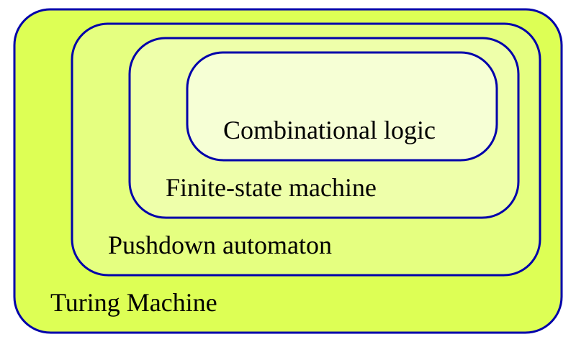
Automata Theory levels of computation
53
Notes:
https://en.wikipedia.org/wiki/File:Automata_theory.svg

Slide 54


Proof Assistants
Initial idea was to use Proof Assistants for the proof
Impossible => Solution to the Halting Problem for all Proof assistants
All well-formed proofs written to a proof assistant must be valid. Thus, they all halt.
Impossible to use a Non-TC system to show that a system is TC
54
Notes:
https://calebstanford.com/2019/01/15/coq-vector-image/
https://writinglinesofcode.com/blog/tlaplus-part-01

Slide 55
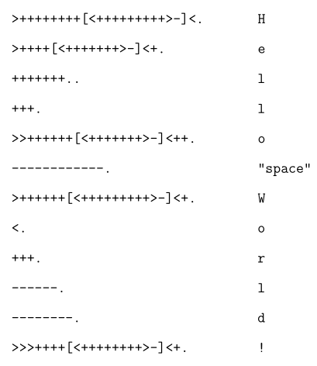
Brainfuck
One of the simplest known TC programming languages
30K byte cell array with an I/O mechanism
Brainfuck Instruction set
“Hello World!” in Brainfuck
55

Slide 56

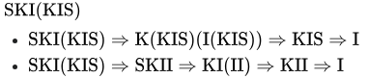
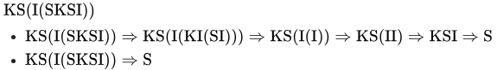
SKI Combinator Calculus
SKI combinator calculus defines 3 rules:
Ix =x
Kxy = x
Sxyz = xz(yz)
Can be likened to a reduced version of Lambda Calculus
Examples of SKI Combinator Calculus reductions
56
Notes:
https://en.wikipedia.org/wiki/SKI_combinator_calculus

Slide 57
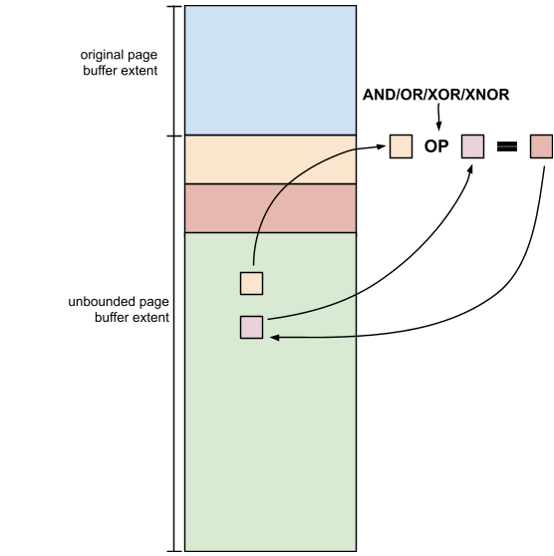
Why does TC matter? - Security
If a TM can do anything*, then it if a bad actor can get ahold of it, then they will cause harm to the system/user
Important to be cognizant of the weapon that one wields when doing operations
Fire warms the hearth but can also raze a forest
iMessage vulnerability caused by memory overflow
57
Notes:
https://googleprojectzero.blogspot.com/2021/12/a-deep-dive-into-nso-zero-click.html?m=1

Slide 58
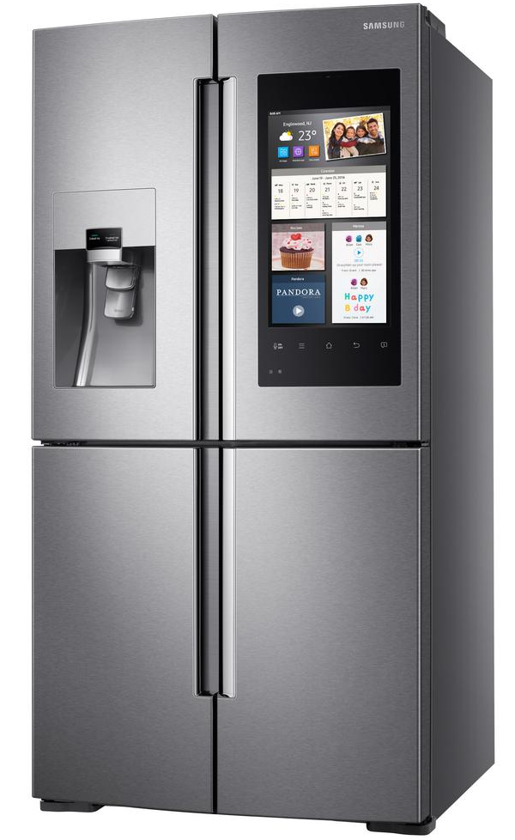
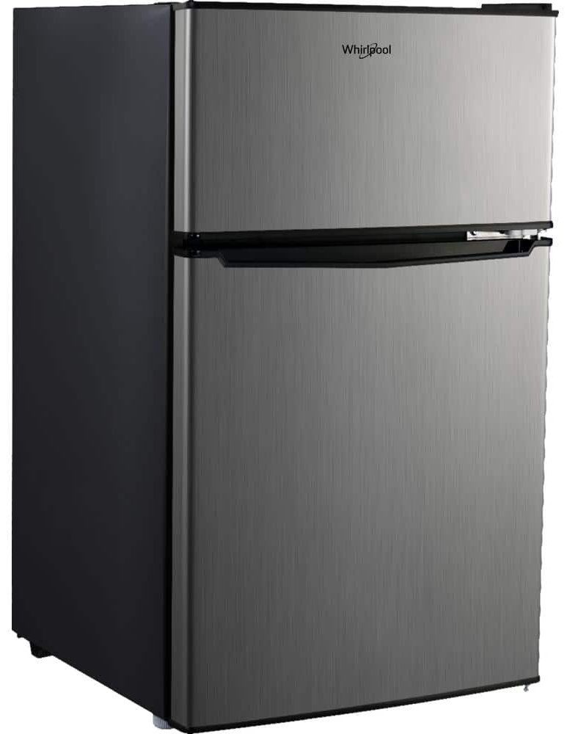
Why does TC matter? – System Limits
To know the limits of the system.
A basic calculator is not TC. Therefore, it cannot be used to perform any malicious behavior.
A general-purpose programming language is TC. This means that programmers should be cognizant of the extent of operations the language can perform.
Smart vs Dumb Fridge have different technological requirements
58
Notes:
https://www.homedepot.com/p/Samsung-27-9-cu-ft-Family-Hub-4-Door-Flex-French-Door-Smart-Refrigerator-in-Stainless-Steel-RF28M9580SR/301328390
https://www.homedepot.com/p/Whirlpool-3-1-cu-ft-Compact-Mini-Fridge-in-Stainless-Steel-with-Dual-Door-True-Freezer-WHR31TS4E/313862801

Slide 59
What is Undecidability?
There is no algorithm to answer the question proposed, and it is impossible to create one.
E.g. The Halting Problem:
Given an arbitrary program, can one determine if the program will finish running (halt)?
?
59

Slide 60
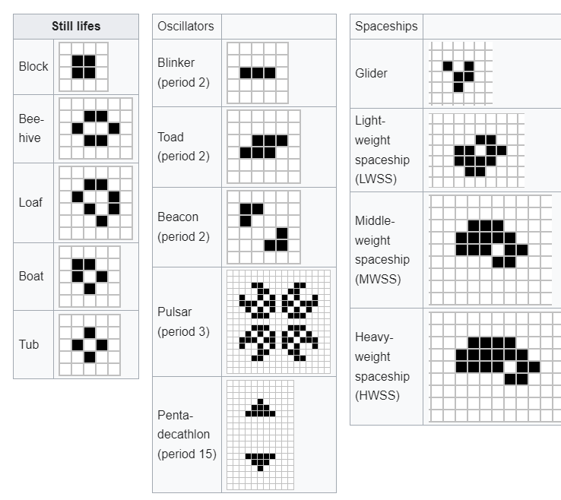
How is CGoL TC?
Undecidable whether one state can reach another in general
Class 4 cellular automaton according to Wolfram, meaning that an initial config may have chaotic or oscillating behavior after an indeterminate amount of time
Different structures for CGoL
60
Notes:
https://en.wikipedia.org/wiki/Conway's_Game_of_Life

Slide 61
How is Rule 110 TC?
Undecidable whether one state can reach another in general
Class 4 cellular automaton according to Wolfram, meaning that an initial display may have chaotic or oscillating behavior for an indefinite amount of time
Rule 110 animated
61
Notes:
“File:One-d-cellular-automaton-rule-110.gif - Wikimedia Commons,” Wikimedia.org, Nov. 20, 2018. https://commons.wikimedia.org/wiki/File:One-d-cellular-automaton-rule-110.gif

